Slide 1
Flow of Control

Slide 2
C# provides the flow-of-control constructs common to modern programming languages.
• Conditional execution executes or skips a section of code depending on a condition. The conditional execution statements are the following:
– if
– if...else
– switch
• Looping statements repeatedly execute a section of code. The looping statements are the following:
– while
– do
– for
– foreach

Slide 3
• Jump statements change the flow of control from one section of code to a specific statement in another section of code. The jump statements are the following:
– break
– continue
– return
– goto
– throw
Conditional execution and looping constructs (other than foreach) require a test expression, or condition, to determine where the program should continue execution.

Slide 4
The if Statement
The if statement implements conditional execution. The syntax for the if statement is shown here, and is illustrated in Figure 9-1.
• TestExpr must evaluate to a value of type bool.
• If TestExpr evaluates to true, Statement is executed.
• If it evaluates to false, Statement is skipped.
İf( TestExpr )
Statement
// With a simple statement
if( x <= 10 )
z = x – 1; // Single statement, no curly braces needed
// With a block
if( x >= 20 )
{
x = x – 5; // Block--braces needed
y = x + z;
}
int x = 5;
if( x ) // Error: test expression must be a bool, not int
{
...
}

Slide 5
// With a simple statement
if( x <= 10 )
z = x – 1; // Single statement, no curly braces needed
// With a block
if( x >= 20 )
{
x = x – 5; // Block--braces needed
y = x + z;
}
int x = 5;
if( x ) // Error: test expression must be a bool, not int
{
...
}

Slide 6
The if . . . else Statement
The if...else statement implements a two-way branch. The syntax for the if...else statement is shown here.
• If TestExpr evaluates to true, Statement1 is executed.
• If it evaluates to false, Statement2 is executed instead.
If( TestExpr )
Statement1
else
Statement2
If( x <= 10 )
z = x – 1; // Single statement
else
{ // Multiple statements--block
x = x – 5;
y = x + z;
}

Slide 7
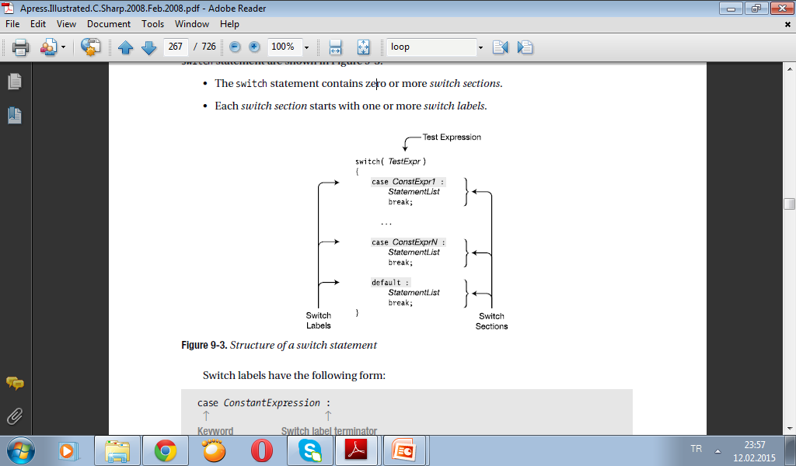
The switch Statement
The switch statement implements multi-way branching. The syntax and structure of the
switch statement are shown in Figure 9-3.
• The switch statement contains zero or more switch sections.
• Each switch section starts with one or more switch labels.

Slide 8
case ConstantExpression :
↑ ↑
Keyword Switch label terminator
The flow of control through the structure in Figure 9-3 is the following:
• The test expression, TestExpr, is evaluated at the top of the construct.
• If the value of TestExpr is equal to the value ConstExpr1, the constant expression in the
first switch label, then the statements in the statement list following the switch label are
executed, until the break statement is encountered.
• Each switch section must end with a break statement (or a goto statement, as discussed
later).
• The break statement branches execution to the end of the switch statement.
• The default section is optional, but must include a break statement, if included.

Slide 9
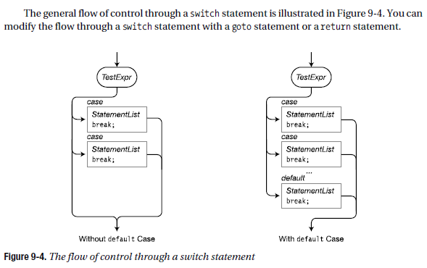

Slide 10
A Switch Example
The following code executes the switch statement five times, with the value of x ranging from 1 to 5. From the output, you can tell which case section was executed on each cycle through the loop.
for( int x=1; x<6; x++ )
{
switch( x ) // Evaluate the value of variable x.
{
case 2: // If x equals 2
Console.WriteLine ("x is {0} -- In Case 2", x);break; // Go to end of switch.
case 5: // If x equals 5
Console.WriteLine("x is {0} -- In Case 5", x);break; // Go to end of switch.
default:
// If x is neither 2 nor 5
Console.WriteLine("x is {0} -- In Default case", x);break;
// Go to end of switch.
}
}
x is 1 -- In Default case
x is 2 -- In Case 2
x is 3 -- In Default case
x is 4 -- In Default case
x is 5 -- In Case 5

Slide 11
More on the switch Statement
A switch statement can have any number of switch sections, including none (although with none, you’ll get a compiler warning). The default section is not required, as shown in the following example. It is, however, generally considered good practice to include it, since it can catch potential errors.
For example, the switch statement in the following code has no default section. The
switch statement is inside a for loop, which executes the statement five times, with the value of x starting at 1 and ending at 5.
for( int x=1; x<6; x++ )
{
switch( x )
{
case 5:
Console.WriteLine("x is {0} -- In Case 5", x);
break;
}
}
The output of the program is
x is 5 -- In Case 5

Slide 12
The followıng code has only the default part
for( int x=1; x<4; x++ )
{
switch( x )
{
default:
Console.WriteLine("x is {0} -- In Default case", x);
break;
}
}
This code produces the following output:
x is 1 -- In Default case
x is 2 -- In Default case
x is 3 -- In Default case

Slide 13
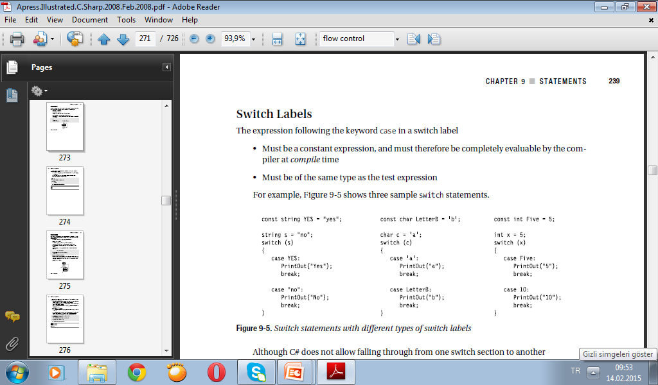
Switch Labels
The expression following the keyword case in a switch label
• Must be a constant expression, and must therefore be completely evaluable by the compiler at compile time
• Must be of the same type as the test expression
For example, Figure 9-5 shows three sample switch statements.

Slide 14
Although C# does not allow falling through from one switch section to another
• You can attach multiple switch labels to any switch section.
• Following the statement list associated with a case, there must be a break or goto statement before the next switch label, unless there are no intervening executable statements between the switch labels.
For example, in the following code, since there are no executable statements between the first three switch labels, it’s fine to have one follow the other. Cases 5 and 6, however, have an executable statement between them, so there must be a break or goto statement before case 6.
switch( x )
{
case 1: // Acceptable
case 2:
case 3:
... // Execute this code if x equals 1, 2, or 3.
break;
case 5:
Y = x + 1;
case 6: // Not acceptable because there is no break
...

Slide 15
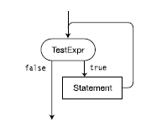
The while Loop
The while loop is a simple loop construct in which the test expression is performed at the top of the loop. The syntax of the while loop is shown below, and is illustrated in Figure.
• First, TestExpr is evaluated.
• If TestExpr evaluates to false, then execution continues after the end of the while loop.
• Otherwise, when TestExpr evaluates to true, then Statement is executed, and TestExpr is evaluated again. Each time TestExpr evaluates to true, Statement is executed another time. The loop ends when TestExpr evaluates to false.
while( TestExpr )
Statement

Slide 16
The following code shows an example of the while loop, where the test expression variable starts with a value of 3 and is decremented at each iteration. The loop exits when the value of the variable becomes 0.
int x = 3;
while( x > 0 )
{
Console.WriteLine("x: {0}", x);
x--;
}
Console.WriteLine("Out of loop");
This code produces the following output:
x: 3
x: 2
x: 1
Out of loop

Slide 17
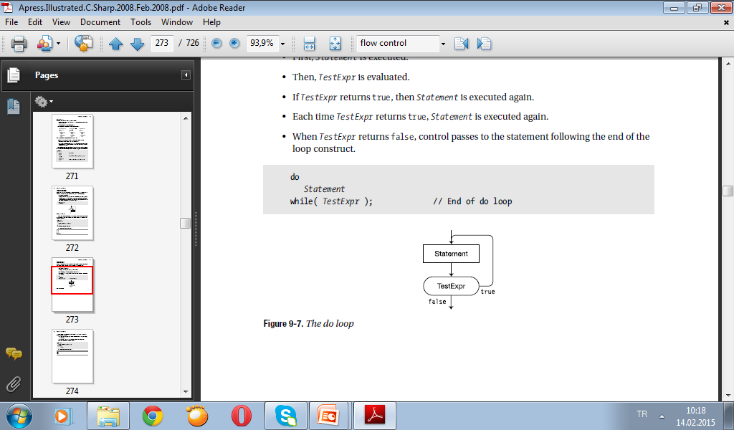
The do Loop
The do loop is a simple loop construct in which the test expression is performed at the bottom of the loop. The syntax for the do loop is shown here and illustrated in Figure 9-7.
• First, Statement is executed.
• Then, TestExpr is evaluated.
• If TestExpr returns true, then Statement is executed again.
• Each time TestExpr returns true, Statement is executed again.
• When TestExpr returns false, control passes to the statement following the end of the loop construct.
do
Statement
while( TestExpr ); // End of do loop

Slide 18
The do loop has several characteristics that set it apart from other flow-of-control constructs.
They are the following:
• The body of the loop, Statement, will always be executed at least once, even if TestExpr
is initially false.
• The semicolon is required after the closing parenthesis of the test expression.
The following code shows an example of a do loop:
int x = 0;
do
Console.WriteLine("x is {0}", x++);
while (x<3) ;
↑
Required
The output of the program
x is 0
x is 1
x is 2

Slide 19
The for Loop
The for loop construct executes the body of the loop as long as the test expression returns true when it is evaluated at the top of the loop. The syntax of the for loop is shown here and illustrated in Figure
• At the beginning of the for loop, Initializer is executed once.
• TestExpr is then evaluated.
• If it returns true, Statement is executed, followed by IterationExpr.
• Control then returns to the top of the loop, and TestExpr is evaluated again.
• As long as TestExpr returns true, Statement, followed by IterationExpr, will be executed.
• As soon as TestExpr returns false, execution continues at the statement following
Statement.
for( Initializer ; TestExpr ; IterationExpr )
Statement
Some parts of the statement are optional.
• Initializer, TestExpr, and IterationExpr are all optional. Their positions can be left
blank. If the TestExpr position is left blank, the test is assumed to return true. Therefore,
there must be some other method of exiting the statement if the program is to avoid
going into an infinite loop.
• The semicolons are required.

Slide 20
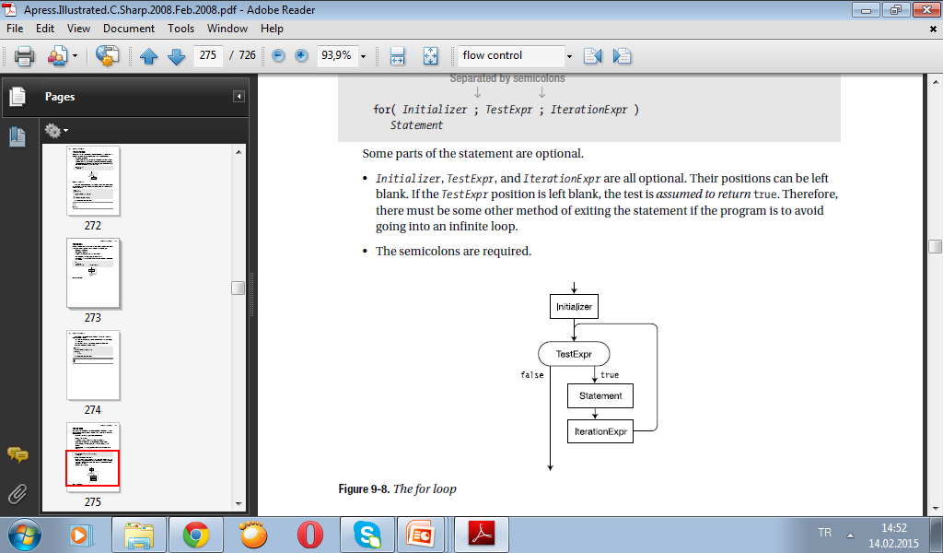
Figure illustrates the flow of control through the for statement. You should also know the following about its components:
• Initializer is executed only once, before any other part of the for construct. It is usually used to declare and initialize local values to be used in the loop.
• TestExpr is evaluated to determine whether Statement should be executed or skipped. It must evaluate to a value of type bool.
• IterationExpr is executed immediately after Statement, and before returning to the top of the loop to TestExpr.
For example, in the following code:
• Before anything else, the initializer (int i=0) defines a variable called i, and initializes its value to 0.
• The condition (i<3) is then evaluated. If it is true, then the body of the loop is executed.
• At the bottom of the loop, after all the loop statements have been executed, theIterationExpr statement is executed—in this case incrementing the value of i.

Slide 21
For example, in the following code:
• Before anything else, the initializer (int i=0) defines a variable called i, and initializes its value to 0.
• The condition (i<3) is then evaluated. If it is true, then the body of the loop is executed.
• At the bottom of the loop, after all the loop statements have been executed, theIterationExpr statement is executed—in this case incrementing the value of i.
// The body of this for loop is executed three times.
for( int i=0 ; i<3 ; i++ )
Console.WriteLine("Inside loop. i: {0}", i);
Console.WriteLine("Out of Loop");
This code produces the following output:
Inside loop. i: 0
Inside loop. i: 1
Inside loop. i: 2
Out of Loop

Slide 22
The Scope of Variables in a for Statement
Any variables declared in the initializer are visible only within the for statement.
• This is different from C and C++, where the declaration introduces the variable into the enclosing block.
• The following code illustrates this point:
Type is needed here for declaration.
↓
for( int i=0; i<10; i++ ) // Variable i is in scope here, and also
Statement; // here within the statement.
// Here, after the statement, i no longer exists.
Type is needed here again because the previous variable i has gone out of existence.
↓
for( int i=0; i<10; i++ ) // We need to define a new variable i here, since
Statement; // the previous one has gone out of existence.
The local variables declared within the body of the loop are known only within the loop.

Slide 23
Multiple Expressions in the Initializer and Iteration Expression
Both the initializer and the iteration expression can contain multiple expressions as long as they are separated by commas.
For example, the following code has two variable declarations in the initializer and two expressions in the iteration expression:
static void Main( )
{
const int MaxI = 5;
//Two declarations Two expressions
// ↓ ↓
for (int i = 0, j = 10; i < MaxI; i++, j += 10)
{
Console.WriteLine("{0}, {1}", i, j);
}
}
This code produces the following output:
0, 10
1, 20
2, 30
3, 40
4, 50

